Slide 1

Project 4: Loan Charge Offs and Related Variables
Group Members: Ryan Lund, Hamid Nazari, Cristian Guerrero, Lu Ye, Joseph Gonzalez and Stephanie Patrica Anshell
11-16-2023

Slide 2
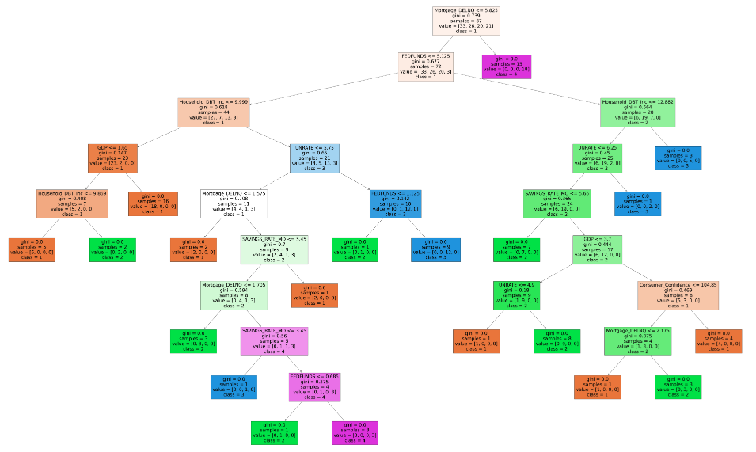
Project 4 Introduction
Project 4 explores the relationship between 4 different types of loan charge offs and variables that may contribute to loan charge offs.
A loan charge off occurs when a bank can no longer collect an outstanding loan balance. This represents a loss to the bank.
Charge offs typically increase during economic recessions when metrics such as the unemployment rate and delinquent loan payments increase.
In our experimental design, loan charges offs are our dependent variables and independent variables include economic metrics and loan related metrics.
We chose 4 different groups of loans to test: Credit Cards, Mortgages, C&I (business) loans and CRE (Commercial Real Estate) loans.
We primarily used four different machine learning methods to test our data: Decision Trees, Random Forests, Logistic Regressions and Deep Learning Networks.

Slide 3
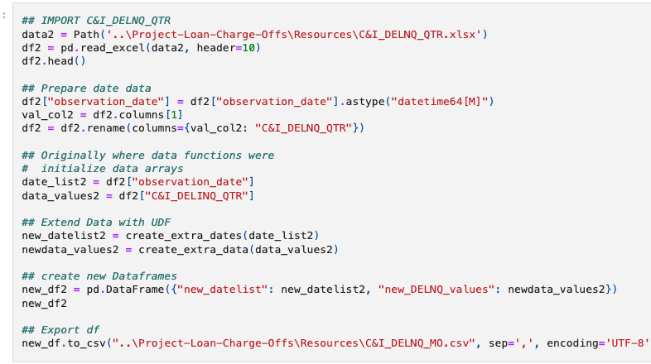
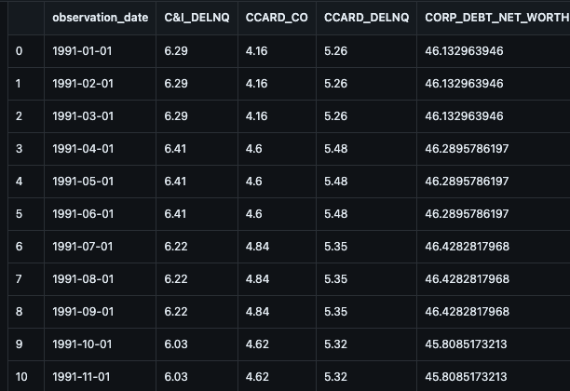
Extract, Transform and Loan (ETL)
The data for Project 4 was exclusively obtained from the Federal Reserve Economic Database (‘FRED’) maintained by the Federal Reserve Bank of St. Louis.
Approximately 20 different variables were chosen to form the 4 loan charge off groups for Project 4. Some variables were reused in all the groups (such as unemployment rate) while other variables were unique to each group.
Overall, there was approximately 9 to 10 independent variables for each group.
The majority of the data obtained from FRED was presented on a quarterly basis while some of the data was presented on a monthly basis. It is not unusual for some economic variables (such as GDP) to be reported on a quarterly basis.
In order to maintain the maximum amount of data, quarterly data was transformed into monthly data with a loop.
In total, the final dataset had approximately 390 rows and dated back to 1991.

Slide 4
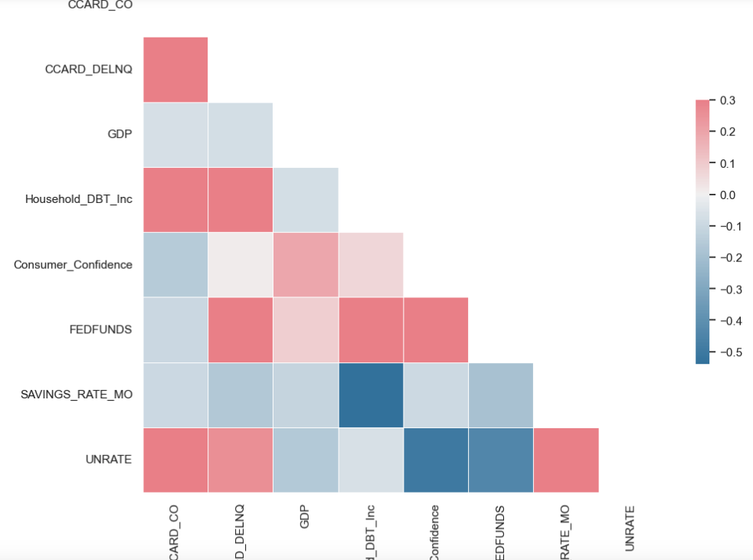
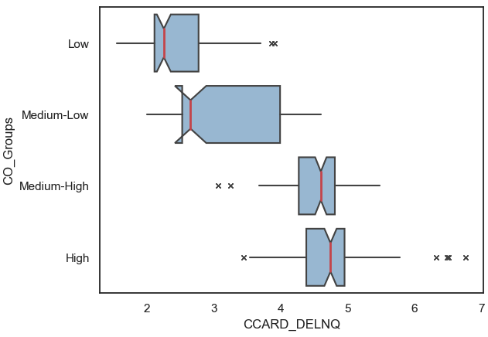
Correlation Matrixes and boxplots
A correlation matrix was created with Seaborn for each loan group. The correlation matrix was the first attempt to visualize the relationship between the variables.
The colors of the correlation matrix corresponded to the strength and direction of the correlation: Darker colors indicated stronger correlations with Red signifying a positive correlation and blue indicating a negative correlation.
For example, The correlation matrix shown here indicates a strong positive correlation between credit card charge offs and delinquencies, household-debt-to-income, and the unemployment rate.
All four loan groups demonstrated positive correlations with delinquencies and the unemployment rate.
The box plot for credit cards was organized into 4 quartiles of charge off risk and showed a strong positive correlation between delinquencies and credit card charge offs.

Slide 5
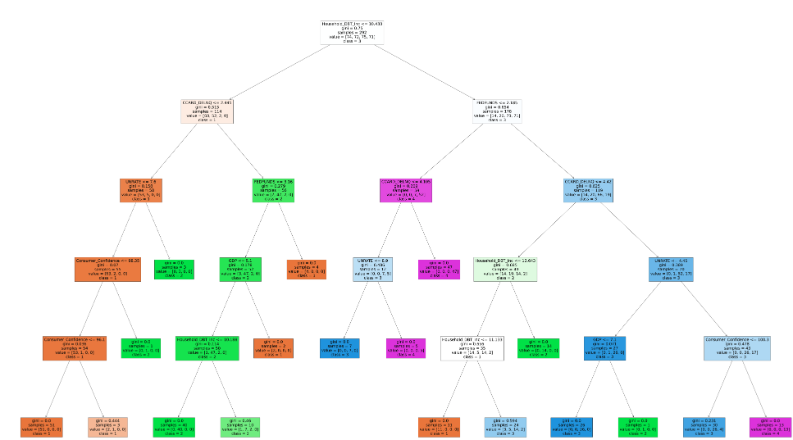
Decision and Random Forest Trees
Decision Trees and Random Forest Trees were amongst some of the highest scoring machine learning models tested in Project 4. For example, the credit card Decision Tree shown here reported a 93.9% accuracy score. Consider the following connection between the variables shown in the Tree:
Along the right branch of the tree, if Household-Debt-to-Income Ratio is above 10.43% and the Fed Funds Rate is above 2.19% and delinquencies are above 4.42% and the unemployment rate is above 4.45% and Consumer Confidence index is above 100.3, then the result is class 4 risk of charge off which signifies the highest quartile of credit card charge off risk.
This branch describes the relationship between several variables in the model: a higher Fed Funds rate could make the Household debt to Income ratio higher indicating a higher load of household debt.
This increased debt load could strain household income and increase the risk of delinquent loan payments. In turn, a higher unemployment rate could cause the risk of delinquent loan payments to go up as there are less jobs available to earn income which is needed to pay make loan payments.
Finally, the Consumer Confidence index could be a leading or lagging indicator for increased credit card charge off risk in the model. In the past, Consumer Confidence has dipped before the onset of an economic recession.

Slide 6
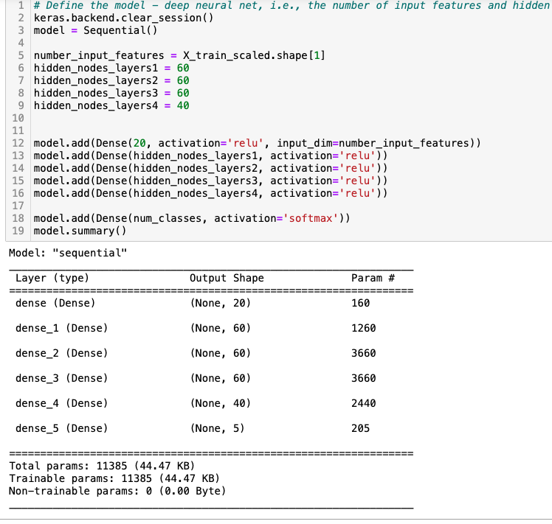
Neural Networks and Deep Learning
Deep Learning models were made for all 4 Loan Groups with the same model design.
For example, the credit cards group reported a 92.9% accuracy score and had the following design characteristics:
4 layers of hidden nodes with 60 nodes for the first 3 layers and 40 nodes for the 4th layer,
The activation type for the 4 hidden layers was ‘relu’,
The activation type for the final layer was ‘softmax’,
There were 200 epochs for the calculation.
The accuracy scores varied from loan group to loan group. Credit cards had the highest accuracy score while the C&I group had the lowest at 74.5%.
Overall, it appears that the Deep learning model did better with Consumer type loans (Credit Cards and Mortgages) versus Commercial type loans (C&I loans and CRE loans).

Slide 7
Project 4 Summary of Model Results
Model Type | Decision Tree (Actual) | Random_Forest (dummies) | Random_Forest (Actual) | Logistic Regression | Deep Learning (actual) |  | Deep Learning (dummies)
Loan Group | Accuracy Score | Accuracy Score | Accuracy Score | Accuracy Score | Accuracy Score | Loss Rate | Accuracy Score | Loss Rate | Overall Accruacy Score*
Credit cards | 93.88% | 88.75% | 94.90% | 80.61% | 92.86% | 27.10% | 25.51% | -6.7051e | 90.20%
Mortgage loans | 91.84% | 94.90% | 93.88% | 86.73% | 90.82% | 30.65% | 32.65% | -8.9701e | 91.63%
C&I loans | 83.67% | 90.82% | 92.86% | 74.48% | 74.49% | 64.97% | 25.51% | -5.8487e | 83.26%
CRE loans | 88.88% | 95.18% | 93.98% | 81.63% | 87.76% | 28.91% | 26.53% | -1.0892e | 89.49%
Average: | 89.57% | 92.41% | 93.91% | 80.86% | 86.48% | 37.91% | 27.55% | N/A
 | *Note: excludes deep learning dummies approach accuracy score.
Random Forest with actual numerical values (as opposed to dummies) produced the highest average accuracy score of 93.91%. The lowest average accuracy score was the Deep Learning model that used dummy values at 27.55%.
Next to the Deep Learning using dummy data, the Logistic Regression model produced the lowest average accuracy score of 80.86%. Compared to Random Forests model (Actual), it appears that Logistic Regressions was less accurate at predicting outcomes.
The Overall Accuracy Score indicated that the Mortgage loans group was the highest at 91.63% and closely followed by the Credit cards group at 90.2%. Overall, the Consumer loans (credit cards and mortgages) performed better than the business loans (C&I and CRE) which appears to be influenced by the Deep Learning model accuracy scores.
The lowest performing loan group was C&I loans with an 83.26% Overall Accuracy Score. This appears to be ‘across the board’ in terms of the model types, and in particular the Logistic Regression model and Deep Learning with actual numerical values model.
It is noted that the different loan groups contain many of the same variables however some unique variables. The group design may have had an affect on the the accuracy scores as well as the different models.

Slide 8
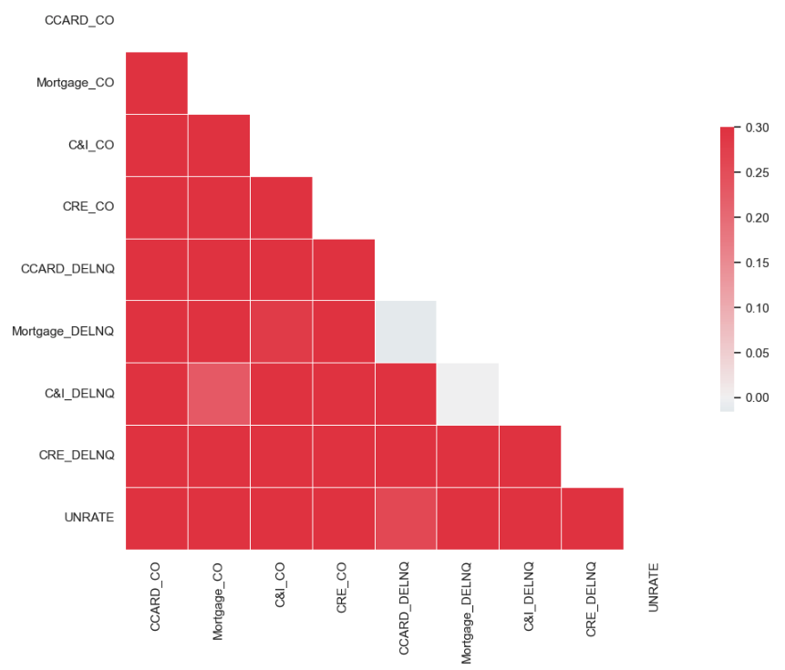
Future Considerations with the data
Time elements could be tested with the existing data set and run through all the models used in Project 4: Time lags and Time deltas.
Time lags would effectively ‘lag’ one or more variables by a period of months. For example, loan charge offs may lag between loan delinquencies and a rising unemployment rate.
Time deltas would calculate the difference between two different points in time for one or more variables. This could reveal if the change in a variable’s value had an affect on loan charge offs.
Other considerations for further studies could be expanding the existing data set where it is possible with the existing variables. For example, what would the accuracy scores look like scaled up 10 times, or 100 times?
There may be limits to scaling up economic variables, however variables such as delinquency rates could hypothetically be measured on a weekly or even daily basis, thus providing a much larger dataset.
Finally, the selection of independent variables could be expanded, changed and reconfigured. For example, further studies on variables and conditions related to C&I loan charges could be explored.
Note: The Correlation Matrix to the right shows that the majority of all 4 loan groups’ delinquencies, charge offs and the unemployment rate are positively correlated.

